Slide 1
Using Remote Sensing to detect irrigation practices in the Qhumanco farms
Ndilisa Didiza
SA-GEO / Kgothatso Innovations

Slide 2
Outline
Background
Statement of the problem
Objectives
Methodology
Results
Conclusion
Proposed Application Areas
Collaborators, stakeholders and Users

Slide 3
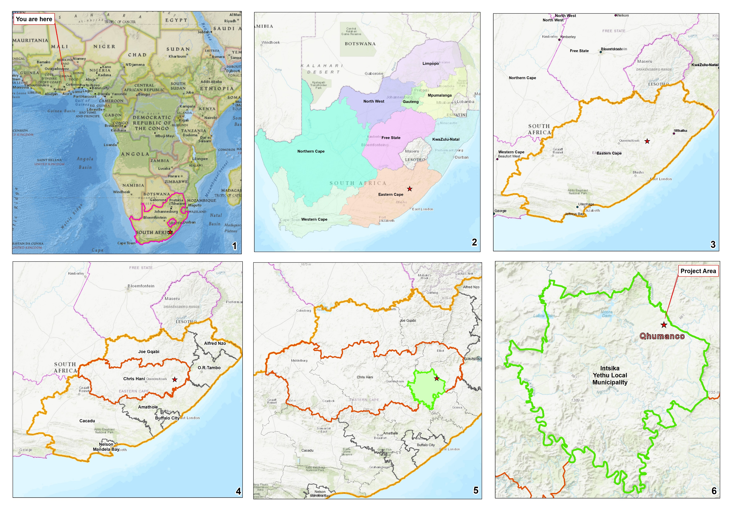
Background

Slide 4
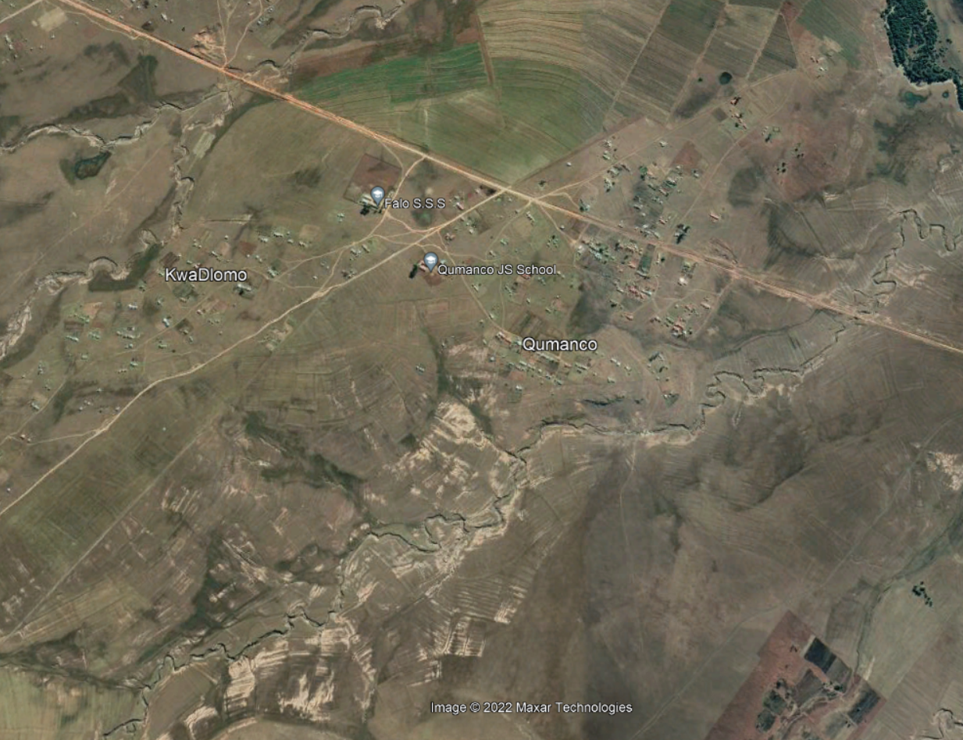
Background
National water act (NWA)
Water use licence (WUL)
No data available
Commercialize today or 12 months later?
Google Earth

Slide 5
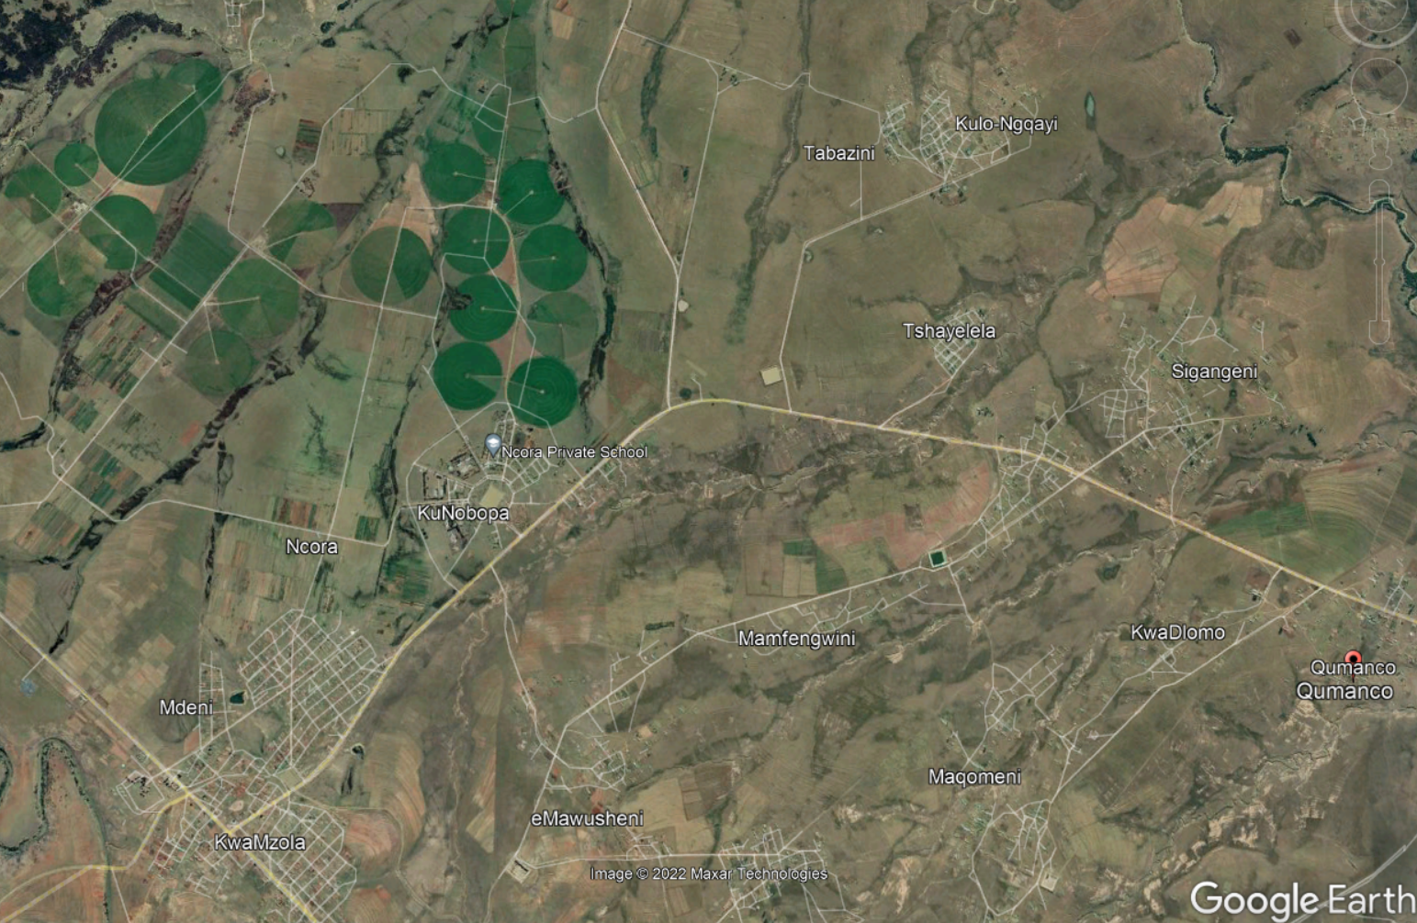
Statement of the Problem
Is there an existing WUL?
- was the area irrigated
historically?

Slide 6
Objective
To determine if area was irrigated and if so, when? And
Do we need a WUL

Slide 7
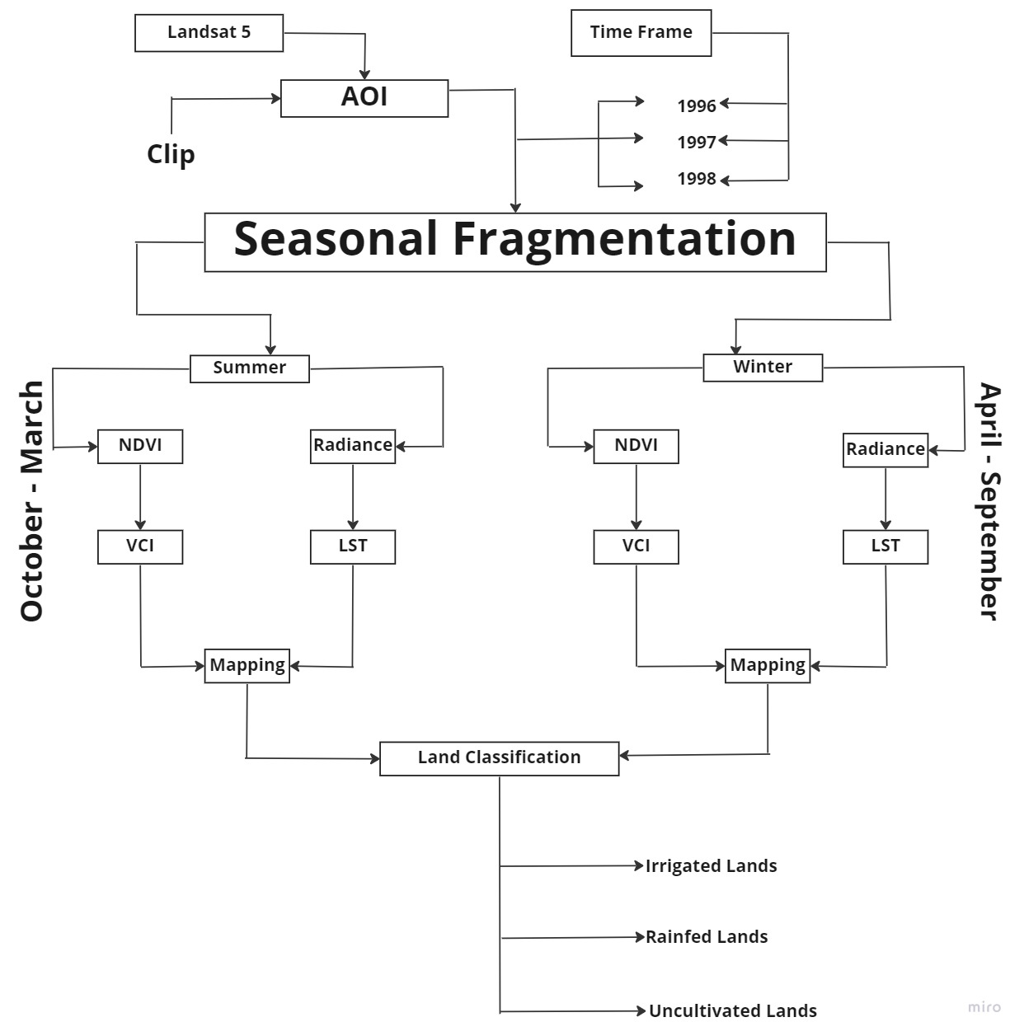
Methodology

Slide 8
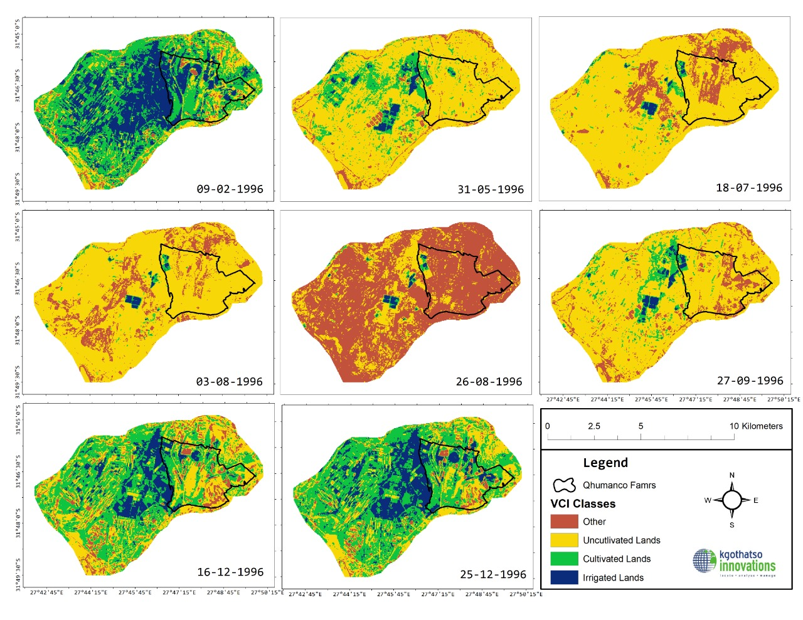
Methodology: VCI Classes 1996

Slide 9
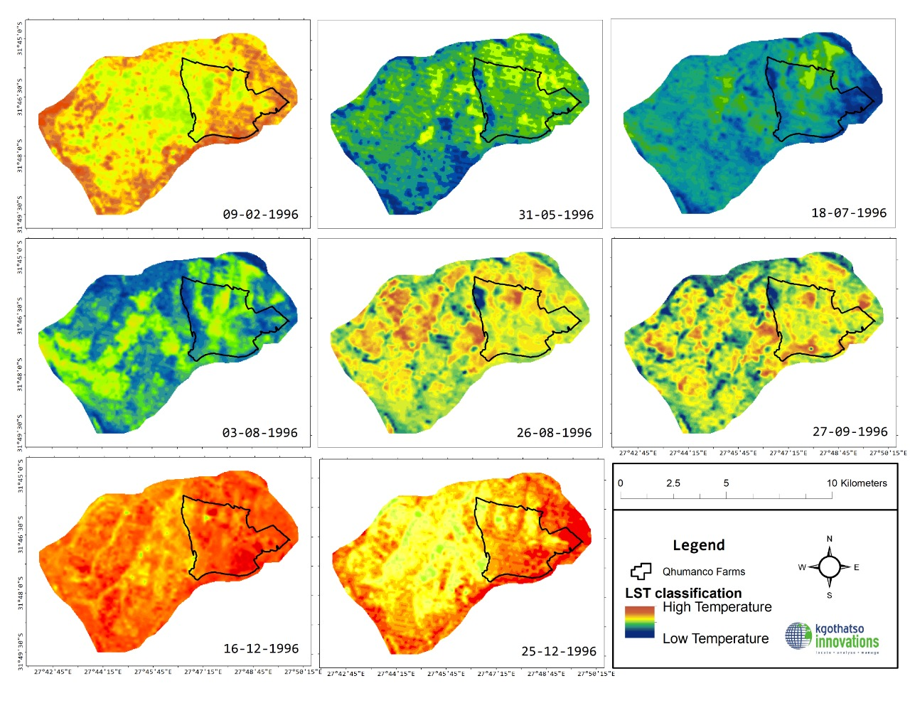
Methodology: LST 1996

Slide 10
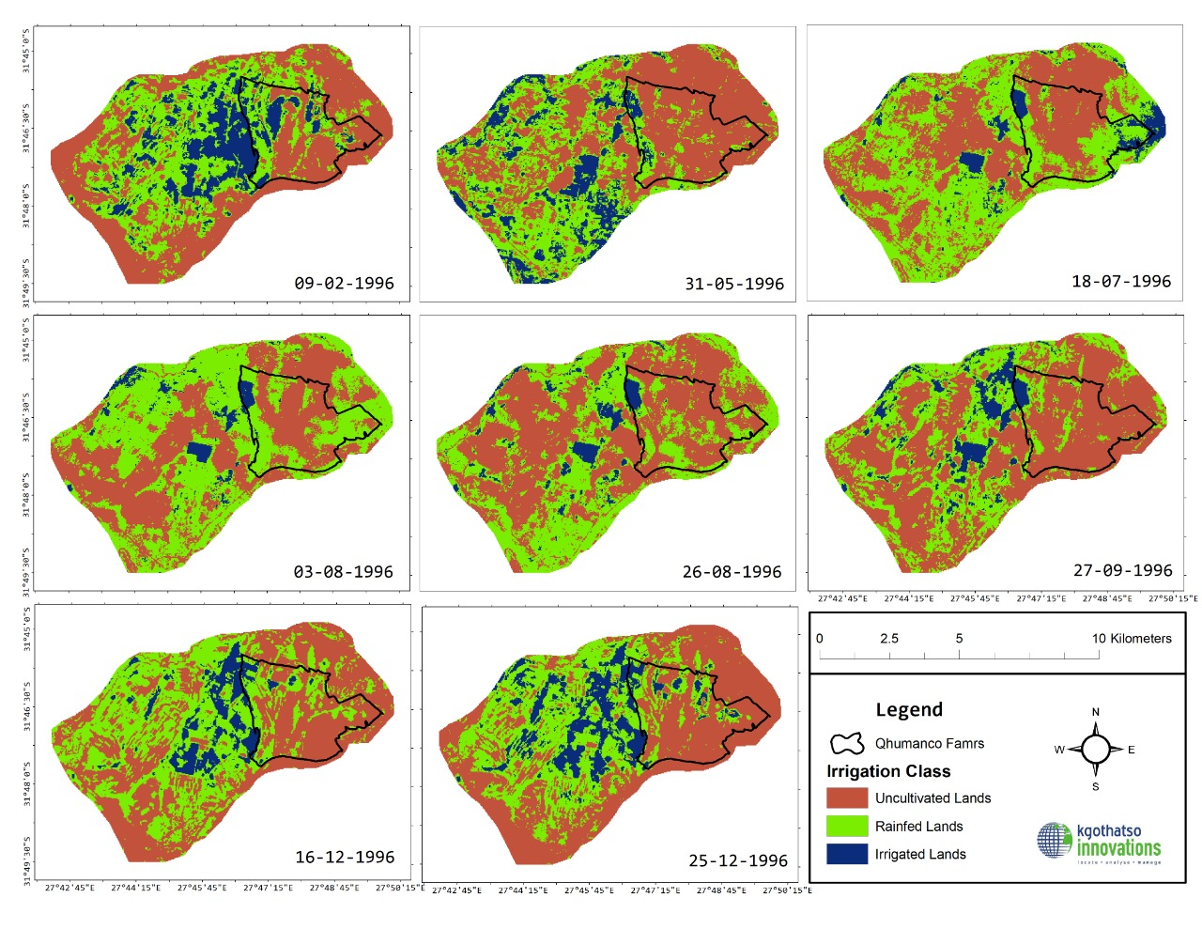
Methodology: Irrigated lands - 1996

Slide 11
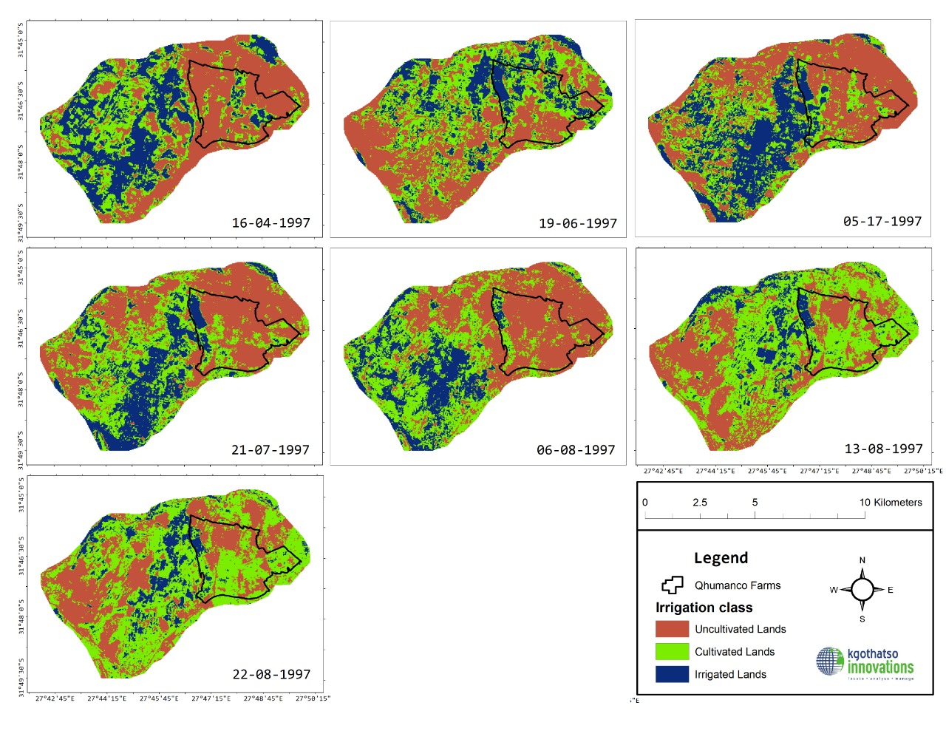
Methodology: Irrigated lands - 1997

Slide 12
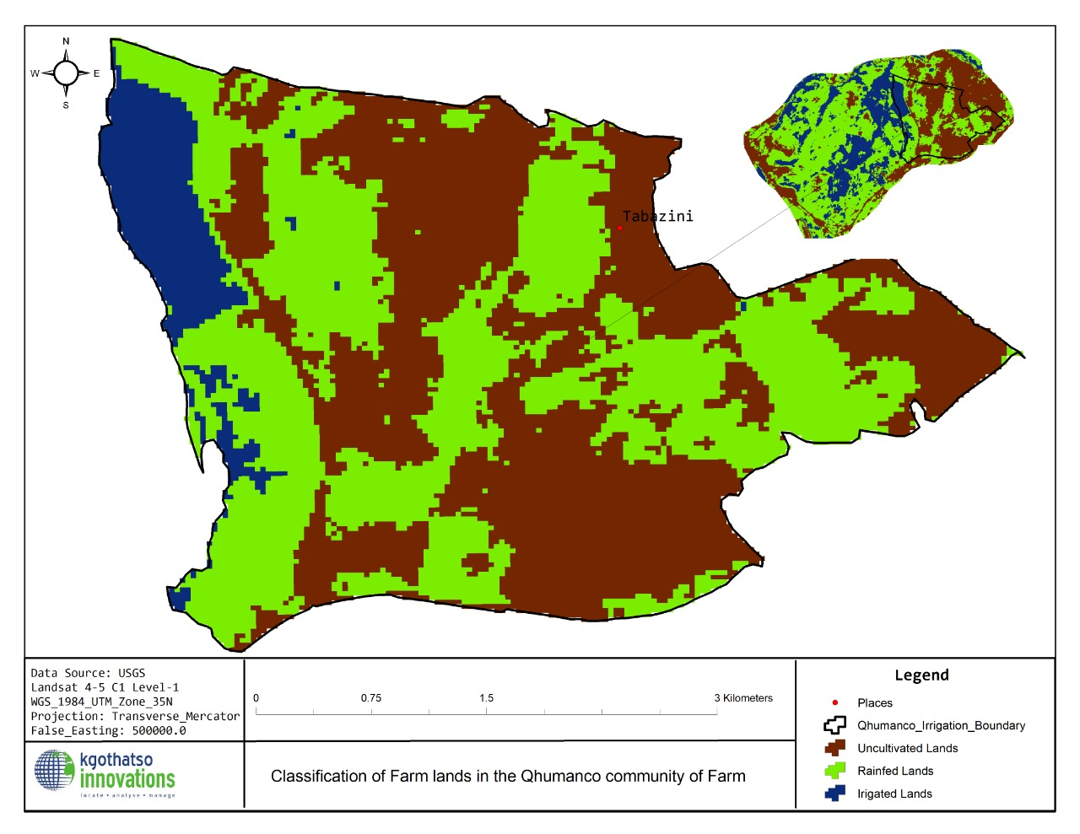
Results
1147.59 ha (out of 3000 ha) was identified as irrigated lands during 1996-1998 .
Irrigation occurred between 1996-1997.
Places
Qhumanco study boundary
Uncultivated lands
Rainfed lands
Irrigated lands

Slide 13
Conclusion
One truth about the irrigation question
WULA necessary = compliant project
Water resources are protected

Slide 14
Proposed application areas of the service &
Collaborators, Stakeholders and Users
Applications:
Land degradation
Urban sprawl
Water pollution
Municipalities
Environmental Practitioners
Communities
Mining (mining boundary encroachment; rehabilitation)
EO data providers
Scientists

Slide 15
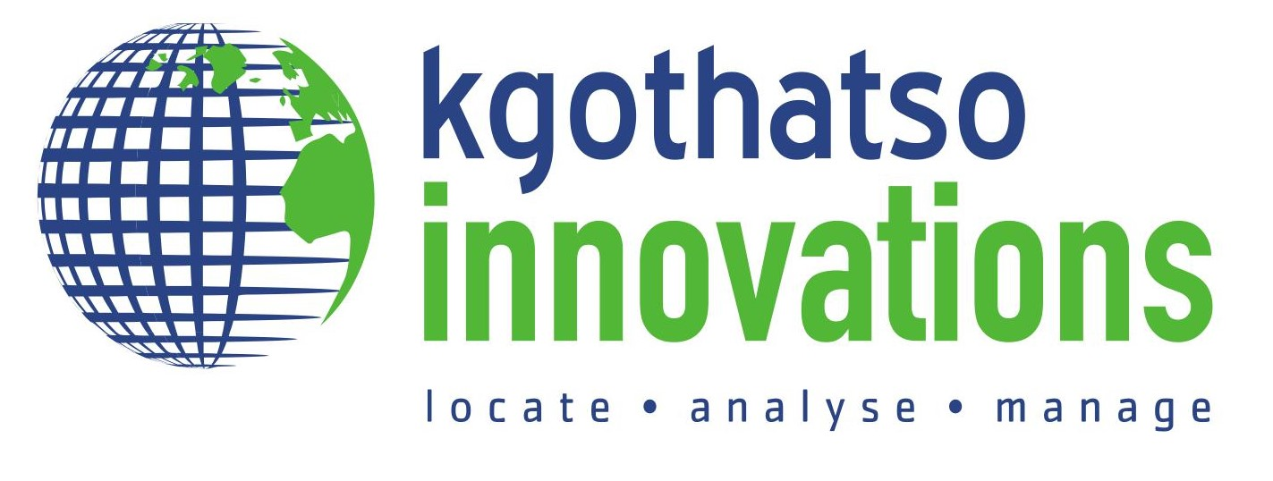
Acknowledgement
^{Ndilisa Didiza}
Kasongo Malunda²
(1) Kgothatso Innovations, South Africa.
(2) Unisa, South Africa.
ndilisa@kgothatsoinnovations.co.za
Qhumanco Agricultural Development Company (Pty) Ltd

Slide 16
Thank you
Questions?

